Slide 1



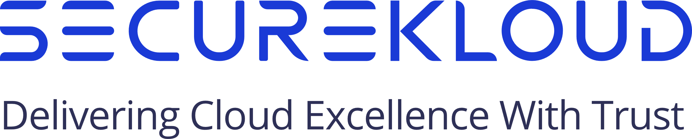
Global Cloud Security and Compliance Trends: What to Expect in 2022
Raj Srinivas
Chief Technology Officer SecureKloud Technologies
Thursday, February 24, 2022 | 8:30 AM EST

Slide 2
Topics
Top 9 Cloud Security Concerns
New and Emerging Best Practices
Key Security and Compliance Trends to Watch
How Enterprises Can Prepare for 2022
Case Study
Why SecureKloud?

Slide 3
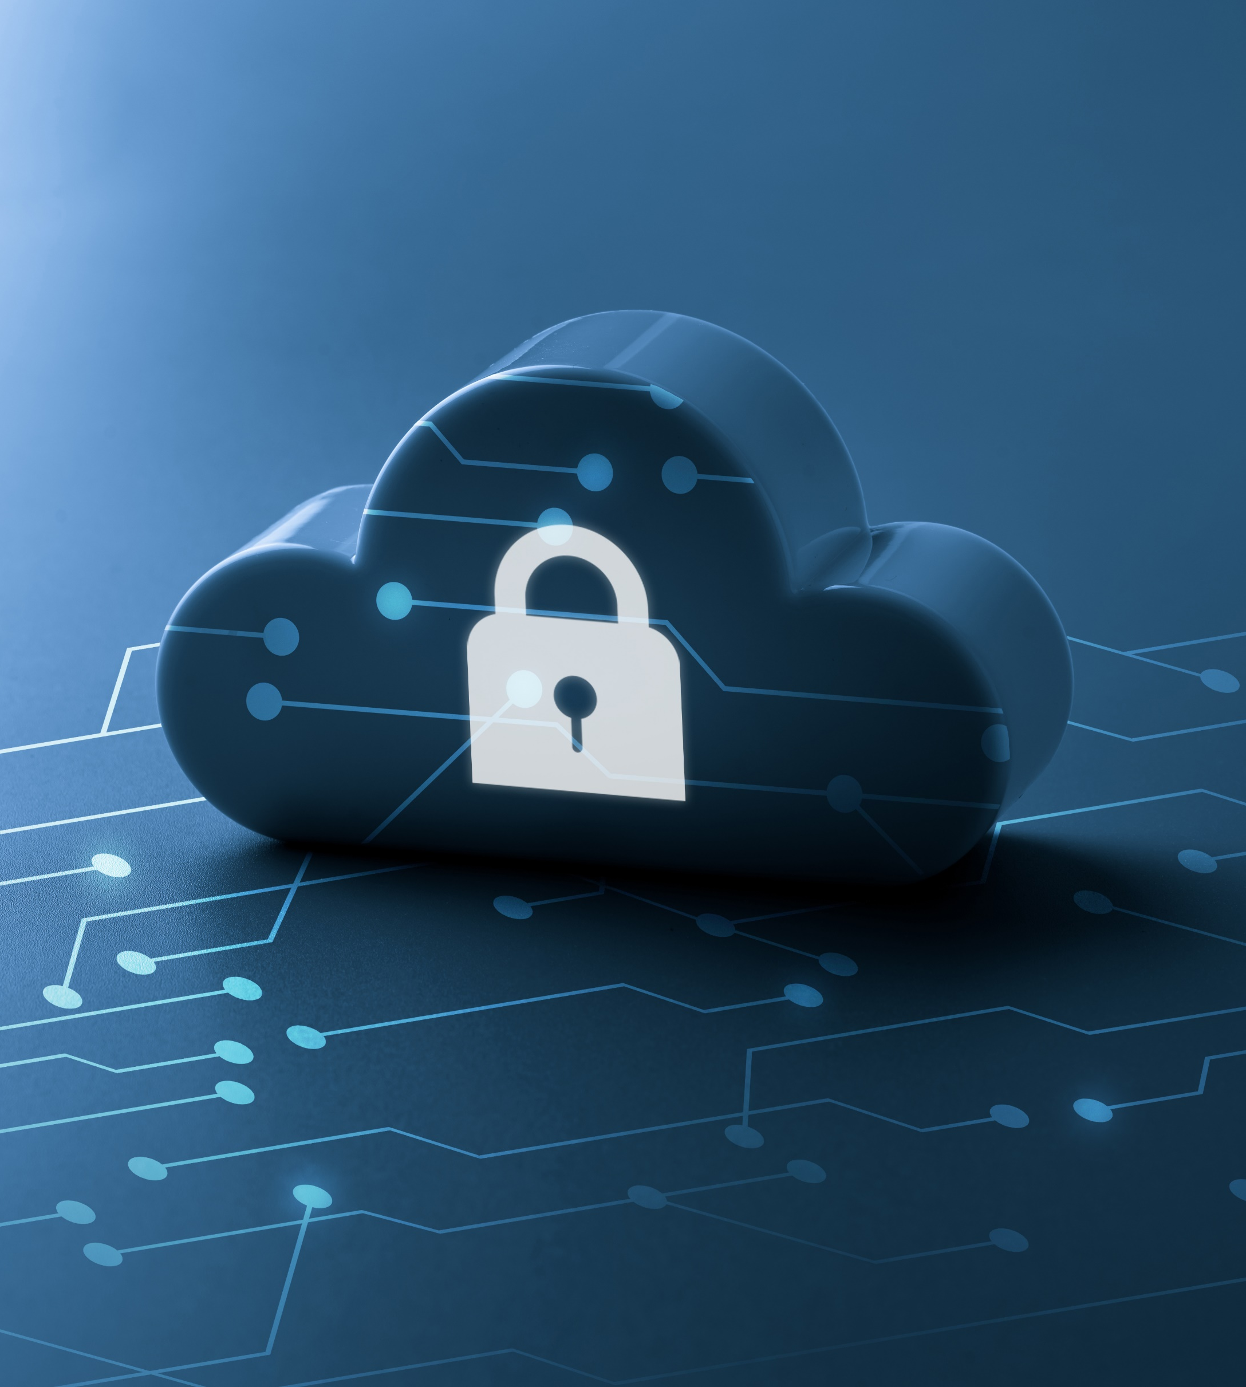
Some Cloud Security Statistics
Security and risk management spending grew 6.4% in 2020
As per a recent study, 79% of enterprises want better integrated security and governance for their data in the cloud
Gartner predicted a growth of 41.2% spending on cloud security in 2021

Slide 4
Top 9 cloud security concerns
01 | Vulnerabilities due to misconfigurations of cloud security settings
02 | Risks associated with identities from other enterprises accessing data
03 | Rising internal security threats and data breaches
04 | Compromise of enterprise networks due to improper Edge/Perimeter security
05 | Lack of device tracking and improper access control

Slide 5
Top 9 cloud security concerns
06 | Authorization as a result of non-zero security permissions
07 | Lack of organic security (DevSecOps) as part of application Development
08 | Security threats due to the lack of cloud-native security tools
09 | Machine and service identity related security breaches

Slide 6

What Do the Analysts Say?
As per the IBM ‘Cost of a Data Breach’ report, the average cost of a data breach in 2021 is US$ 4.24 million.
Misconfiguration of the cloud platform accounts for 62% of Cloud Security Threats, according to Gartner

Slide 7




New and emerging best practices
Device Security
Measures taken to protect data stored on portable devices such as laptops, tablets, smartphones, etc.
Edge Security
Safeguards applications and data at the farthest reaches or “edge” of a company’s network.
Cloud-native Tools for Security
Analyzes the full spectrum of the cloud-native stack including containers, orchestration systems, cloud infrastructure, and microservices.
Cloud Security Posture
CSPM automates the identification and remediation of risks across cloud infrastructures.

Slide 8

Cloud Security Posture
As a cloud-first philosophy becomes the norm, the problem of securing cloud-based systems becomes more acute. CSPM automates the identification and remediation of risks across cloud infrastructures.
“
Gartner states that 95 percent of all security breaches are due to misconfigurations, and those mistakes cost companies $5 trillion between 2018 and 2019 alone.
CSPM is used for risk visualization and assessment, incident response, compliance monitoring, and DevOps integration, and can uniformly apply best practices for cloud security to hybrid, multi-cloud, and container environments.

Slide 9



How does CSPM work?
Discovery & Visibility
Provides complete visibility into your cloud assets and security configurations.
Discovers misconfigurations
Manages security policies through a centralized console
Single source of truth across multi-cloud environments
Misconfiguration Management & Remediation
Eliminates security risks by comparing cloud configurations to industry standards.
Automated remediation of misconfigurations
Database instances and storage are continuously monitored

Slide 10



How does CSPM work?
Continuous Threat Detection
Offers continuous monitoring of the cloud environment and proactively detects threats.
Targeted threat identification and management
Real-time threat detection
Governs Security & Compliance
Audits for adherence to regulatory compliance mandates such as HIPAA, PCI DSS, etc.
DevSecOps Integration
CSPM reduces overhead and manual effort required to oversee multi-cloud environments and can be easily integrated with DevOps tools already in use.

Slide 11

Edge Security
A type of enterprise security for corporate resources that are no longer located within the protective boundaries of a centralized data center.
It solves the problem by providing a built-in security stack to protect against zero-day threats, malware, and other vulnerabilities at the point of access.
Rather than backhauling internet traffic over a WAN network to guard against the perils of internet connectivity, companies can securely steer traffic to the nearest point of access.

Slide 12
Edge Security
Components of Edge Security
Edge device security to protect endpoints
Cloud security to protect data at the edge
Network edge security to protect Internet access

Slide 13

Device Security
Mobile Device Security refers to the measures designed to protect sensitive information stored on and transmitted by laptops, smartphones, tablets, wearables, and other portable devices.
At the root of mobile device security is the goal of keeping unauthorized users from accessing the enterprise network.

Slide 14
Device Security
How does device security work
Establish, share, and enforce clear policies and processes
Password protection
Leverage biometrics
Avoid public Wi-Fi
Beware of apps
Mobile device encryption

Slide 15
Device Security
Types of device security
Enterprise Mobile Management platform
Email security
End point protection
VPN
Secure web gateway
Cloud access security broker

Slide 16

Cloud-native
Tools for Security
Businesses are challenged with having the right tools, people, and processes to monitor and manage the security of their cloud-native environments.
Legacy security tools lack the visibility and control needed to protect modern infrastructure.
Cloud-native security solves security challenges surrounding cloud-native applications.
All major cloud providers offer various cloud-native protection tools, each designed to meet specific security requirements.

Slide 17




Key security and compliance trends to watch
Zero trust Security
Security in Hybrid
and Multi-Cloud Environments
A security model based on the principle of maintaining strict access controls and not trusting anyone by default, even those already inside the network perimeter.
Create a roadmap to a secure hybrid and multi-cloud environment and build out your macro-level security architecture.
DevSecOps
Container Security
Automates the integration of security at every phase of the software development lifecycle, from initial design through integration, testing, deployment, and software delivery.
Implements security tools and policies to protect the container, its application and performance including infrastructure, software supply chain, system tools, system libraries, and runtime against cybersecurity threats.

Slide 18





How enterprises can prepare for 2022
Security Assessment
Security Tools Selection
Identity Security (Zero Trust)
Evaluate cloud infrastructure to determine if the appropriate levels of security and governance have been implemented.
Cloud-native tools can provide more seamless and comprehensive protection for cloud assets.
A zero-trust framework enables enterprises to continuously monitor and validate that a user and their device have the right privileges and attributes.

Slide 19




How enterprises can prepare for 2022
Planning to Implement
Container Technology Adoption
Process Selection for DevSecOps
Enhance the security capabilities of a container so that the applications it houses can run without any vulnerabilities.
A Gartner report states: “By 2023, more than 70% of global organizations will be running more than two containerized applications in production, up from less than 20% in 2019.”
Service Security

Slide 20

Use cases/
Case study
Case Study
One of the top 100 automotive suppliers trusts SecureKloud for a secured cloud infrastructure
Business Challenges
Data protection was a challenge due to the shared responsibility model and automation of the public cloud infrastructure
Ensure continuous compliance and security along with the best practices for the public cloud
Solution
Cloud managed services team enabled flexible 24*7 support services
The monitoring dashboard displays the current operational status of the infrastructure including availability, performance, security, etc., and was observed 24*7 to ensure that the resources stay healthy.
End-to-end technical support for infrastructure security, troubleshooting, and monitoring cloud resources and automation solutions
Outcome
Helped the client to stay ahead of the security curve
A highly manageable, resilient, secured, and compliant cloud architecture

Slide 21





Why SecureKloud?
14+
350+
400+
Years of Experience
Client Engagements
Certified Architects
Specializing in Cloud, DevOps, Security, Automation, Big Data, Analytics and Blockchain
350+ Solutions architects /DevOps engineers with deep expertise on multiple stacks aiding 350+ global customer engagements
Premier Consulting Partner of AWS, recognized partner of Google and expertise in Microsoft Azure
Offers vendor agnostic cloud framework for highly regulated industries to ensure continuous compliance and security in multi/hybrid cloud environments
Leader in Cloud Compliance by meeting HIPAA, PCI, GxP, SOX systems transition to cloud utilizing agile practices and IP tools

Slide 22

THANK YOU!

